Slide 1
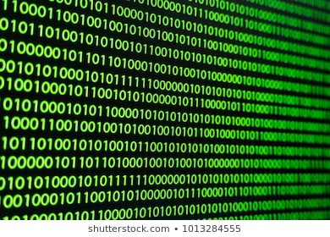
Hackfest 2018
Todd the Sales Bot

Slide 2

LET TODD DO THE ADMIN
LET SALES PEOPLE SELL...
Notes:
from sales to order to provision

Slide 3
LET TODD DO THE ADMIN
LET TECHIES TECH...
Notes:
from sales to order to provision

Slide 4
What does Gartner say?
Gartner forecasts that by 2020, over 85% of customer interactions will be handled without a human.
Today, 72% of people use less than 7 apps per day.
They’re using less of other apps and using more messenger apps.
So with people moving away from apps and toward online messaging, chatbots are an obvious choice for continued personalization:
Essentially this is the interface we are all going to use
Notes:
from sales to order to provision

Slide 5


Client Perspective
Fluid customer engagement
Faster turnaround
Instant quote generation
Direct provisioning and access to infrastructure
DD Perspective
Sales people focus on selling
Cost of sales lowered
Immediate quote to cash
Future Potential
Roadmap for comparative quote analysis
Faster turnaround on leads
Effective utilization of technical teams and sales force
Notes:
We are leading managed service provider and this provides a platform to truly LEAD
Solve for at least the transactional sale

Slide 6
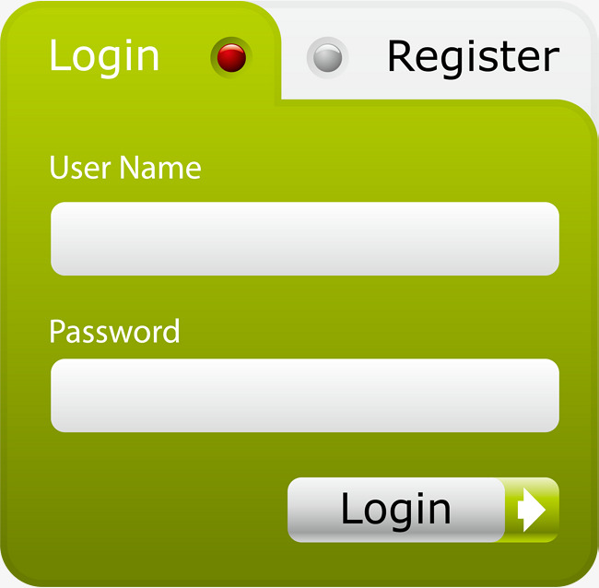
CUSTOMER A
********************

Slide 7

Hello!
Hello Customer A, How can I help you ?
Please will you quote for a virtual server
Sure! What operating system would like ?
Red hat Linux

Slide 8
How many cores would you like ?
2 cores
That’s great ! How much memory would you like :
High performance [HP] or Standard Performance [SP]
HP
Perfect! How much storage would you like in Gb please ?
2000

Slide 9
Great! Are you happy with your configuration ?
You can accept, modify or cancel
Accept
Fantastic! Your price for the server will be R2000.00 per month.
You may accept, modify or delete the quote
Accept
Thank you very much your virtual machine is provisioned, your I.P is
10.01. 56/26

Slide 10
Hackfest 2018
Chatbot Provisioning

Slide 11
From interaction to instance
Notes:
Infrastructure as code (IaC) is the process of managing and provisioning computer data centers through machine-readable definition files, rather than physical hardware configuration or interactive configuration tools.
The IT infrastructure managed by this comprises both physical equipment such as bare-metal servers as well as virtual machines and associated configuration resources.

Slide 12
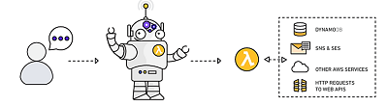


Our Solution
Enables the sale and provisioning of infrastructure through an interactive interface driven by Todd
Allocates necessary resources to instance based on client requirements gathered by Todd
Instantly fulfil client infrastructure needs
Data
Communication
Cloud
Previsioning

Slide 13

Demo
Demo

